Slide 1
Text Mining
Applied Text Mining in Python

Slide 2





Introduction to Text Mining
Text is everywhere!
Text data is growing fast!
Data continues to grow exponentially
- Estimated to be 2.5 million TB a day
- Grows to 40 billion TB by 2020
* About 80% of all data is estimated to be unstructured data

Slide 3
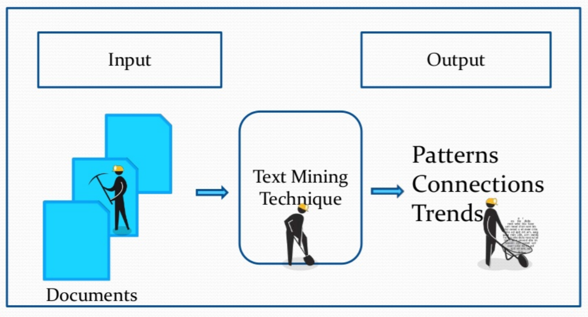
What is Text Mining?
Turn text data into high-quality information or actionable knowledge
Find / Identify / Extract relevant information from text
Parse text
Classify text documents
Search for relevant text documents
Sentiment Analysis
Topic Modelling

Slide 4
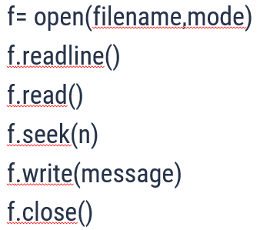
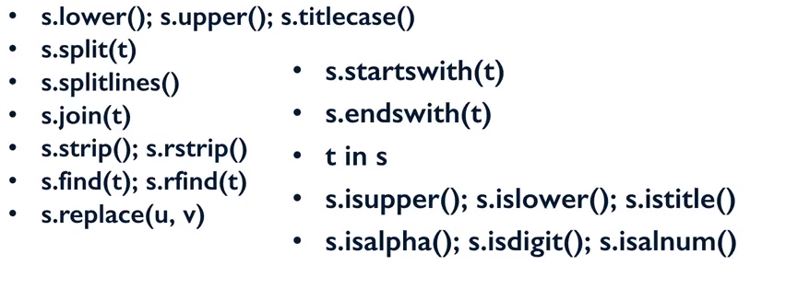
Handling Text in Python
File Operations
String Operations

Slide 5
Regular Expressions
A regular expression is a special sequence of characters that helps you match or find other strings or sets of strings, using a specialized syntax held in a patternAnd some text
For instance, a regular expression could tell a program to search for specific text from the string and then to print out the result accordingly. Expression can include
-Text matching -Branching
-Repetition -Pattern-composition etc

Slide 6
Python modules
Pandas
- A software library written for the Python programming language for data manipulation and analysis.
- In particular, it offers data structures and operations for manipulating numerical tables and time series.
Regex
- This module provides regular expression matching operations
- A regular expression (or RE) specifies a set of strings that matches it; the functions in this module let you check if a particular string matches a given regular expression

Slide 7
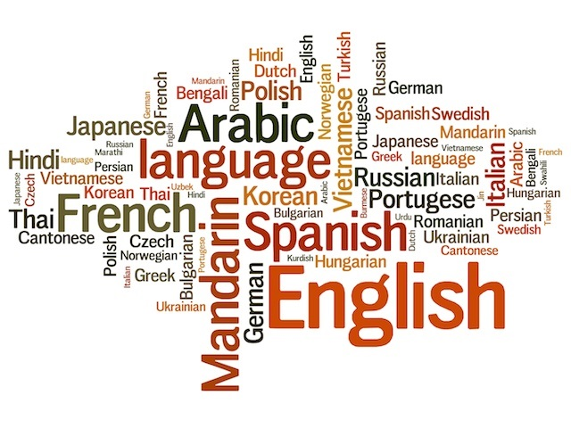
Natural Language Processing

Slide 8
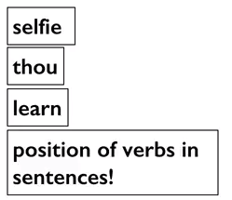
What is Natural Language Processing ?
Any computation , manipulation of natural language
Natural languages evolve
New words get added
Old words lose popularity
Meanings of words change
Language rules themselves may change

Slide 9

What can Natural Language Processing do?
NLTK: Natural Language Toolkit
Open source library in Python
Has support for most NLP tasks
Also provides access to numerous text corpora
Counting words , counting frequency of words
Finding sentence boundaries
Parts of Speech (POS) tagging
Parsing the sentence structure
Identifying semantic roles

Slide 10
Natural Language Processing Tasks
Count #1
Counting vocabulary of words and sentences using len(text)
Count #2
Counting unique words in a given text file using len(set(text))
Stemming
Stemmers remove morphological affixes from words, leaving only the word stem
Lematization
A very similar operation to stemming is called lemmatizing. The major difference between these is, as you saw earlier, stemming can often create non-existent words, whereas lemmas are actual words.
Tokenization
Given a character sequence and a defined document unit, tokenization is the task of chopping it up into pieces, called tokens , perhaps at the same time throwing away certain characters, such as punctuation
POS tagging
A Part-Of-Speech Tagger (POS Tagger) is a piece of software that reads text in some language and assigns parts of speech to each word (and other token), such as noun, verb, adjective, etc.

Slide 11
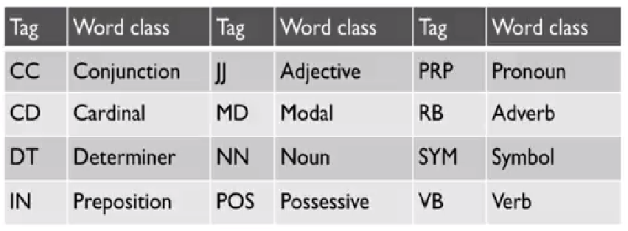
Parts of Speech (POS) Tagging

Slide 12
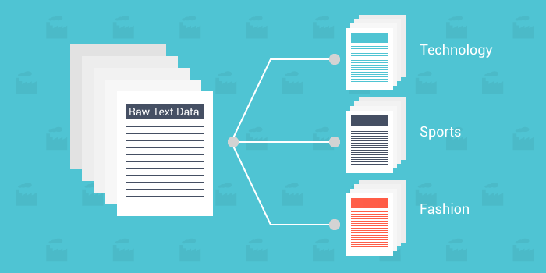
Text Classification
Given a set of classes
Classification : Assign the correct class label to the given input

Slide 13
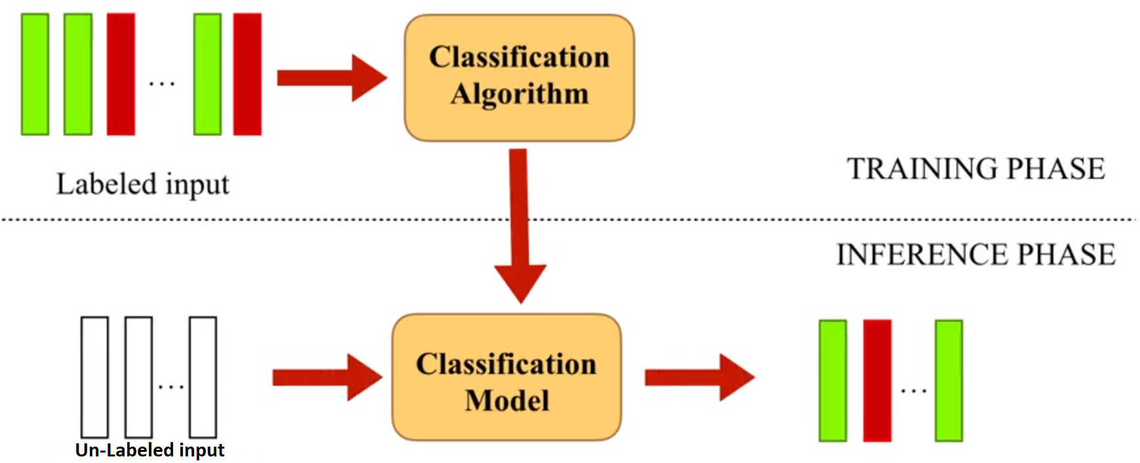
Supervised Classification
Supervised Learning
Humans learn from past experiences , machines learn from past instances!
Learn a classification model on properties(features) and their importance(weights) from labeled instances

Slide 14
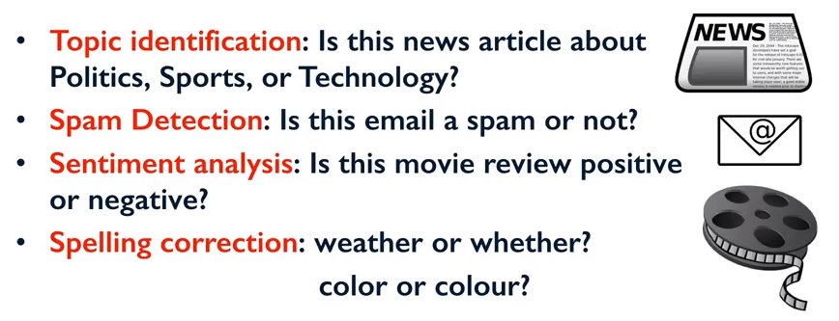
Text Classification
Examples of Text Classification

Slide 15
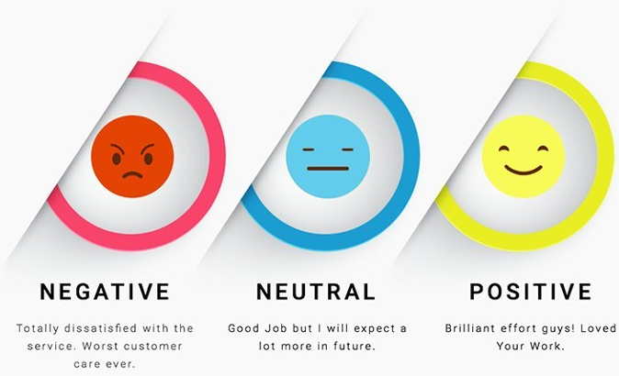
Sentiment Analysis
The process of computationally identifying and categorizing opinions expressed in a piece of text, especially in order to determine whether the writer's attitude towards a particular topic, product, etc. is positive, negative, or neutral.

Slide 16



Case Study Demo
Case Study : Amazon_Unlocked_Mobile.csv
Module 1 : sem1.py - Text Extraction
Module 2 : sem2.py - Text Classification
Module 3 : sem3.py - Sentiment Analysis
SciKIT : classification, regression and clustering algorithms .
NumPy : support for large, multi-dimensional arrays and matrices .
SciPy : for scientific computing and technical computing .
SciPy

Slide 17
Merits of Text Mining
Database limits itself to Storage of less Information whereas Text Mining overcomes this limitation.
Extraction of relevant Information and Relationships from Natural Documents.
Extraction of Information from Un-structured or Semi-structured Documents
Minimizes human effort(on consuming text data)
Supplies knowledge for optimal decision making

Slide 18
Demerits of Text Mining
Requires Initial Learned Information System for Initial Extraction.
Suitable programs needed to be defined to Analyze Text from Mining Knowledge or Information.

Slide 19
Applications of Text Mining
Analysis of Market Trends
Analysis and Screening of Junk Emails
Customer Profile Analysis
Trend Analysis
Information filtering and routing
Event tracks
News stories Classification
Web search etc.

Slide 20
THANKS!

